Slide 1



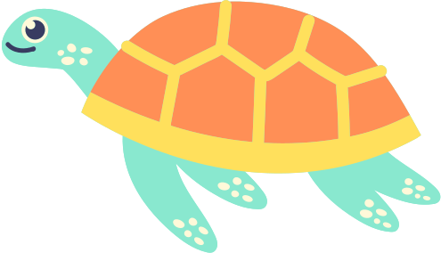






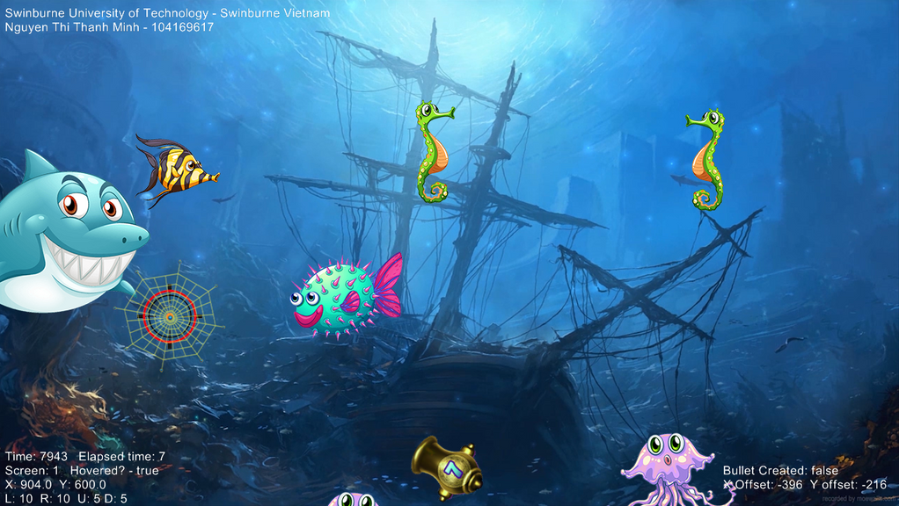
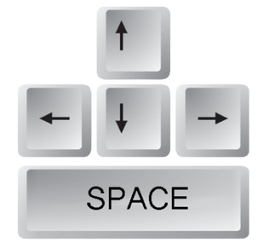


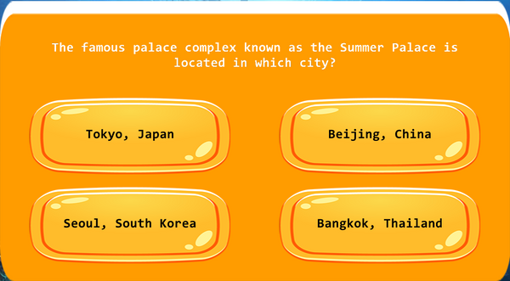


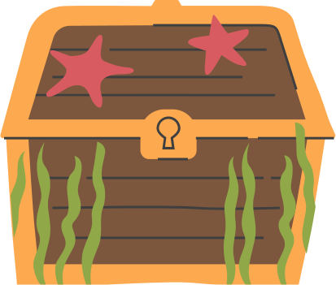

GCED x tech club Game
Cannon Casters
Gameplay
Use a blastin' cannon to cast beautiful fish! Each time you successfully catch a fish, you'll be asked a random question of interesting facts about countries all over the world. Correct answers will be rewarded with amazing gifts!
How It Works
This game is, in fact, a program in Ruby language, utilizing Gosu, a GUI library.
Ruby is a dynamic, object-oriented programming language known for its simplicity and productivity.
Gosu is a 2D game development library for Ruby and C++. Gosu is focused, lightweight and has few dependencies.
Tutorial
Use arrow keys to control the aim mark of the cannon on the screen. Press Space to shoot a bullet towards the desired position, which will be expanded into a net upon reaching goal.
A question will appear randomly when some fish is caught! Choose the correct answer and earn score. Three consecutive correct answers will be rewarded!
Come and play with us!
Swinburne Vietnam, Danang Campus, GCED Program

